Slide 1
Please Sign In

Slide 3
WELCOME BACK TO HSTSA!
HSTSA is a student organization to help YOU connect with CHST’s large and diverse community of students, professors, and faculty. Our large network is here to help you gain knowledge, resources, and opportunities to cultivate experiences and heighten your potential here at RIT!
HSTSA is…. Your voice… Your Growth… Your Experience… Your Organization.
Notes:
Introductions

Slide 4
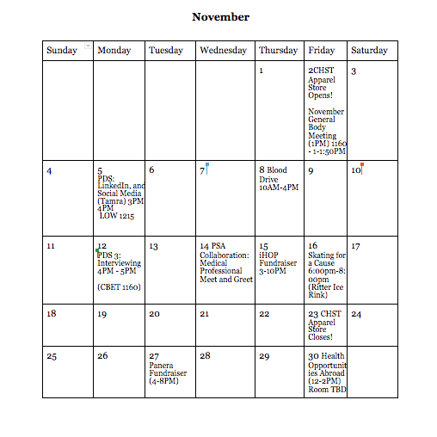
FUTURE EVENTS - Overview of November

Slide 5
FUTURE EVENTS
CHST Apparel Store will be Open Soon!

Slide 6
FUTURE EVENTS
Professional Development Series: LinkedIn and Social Media 101
November 5th, 2018
3-4 PM
LOW 1215
Notes:
Allie

Slide 7
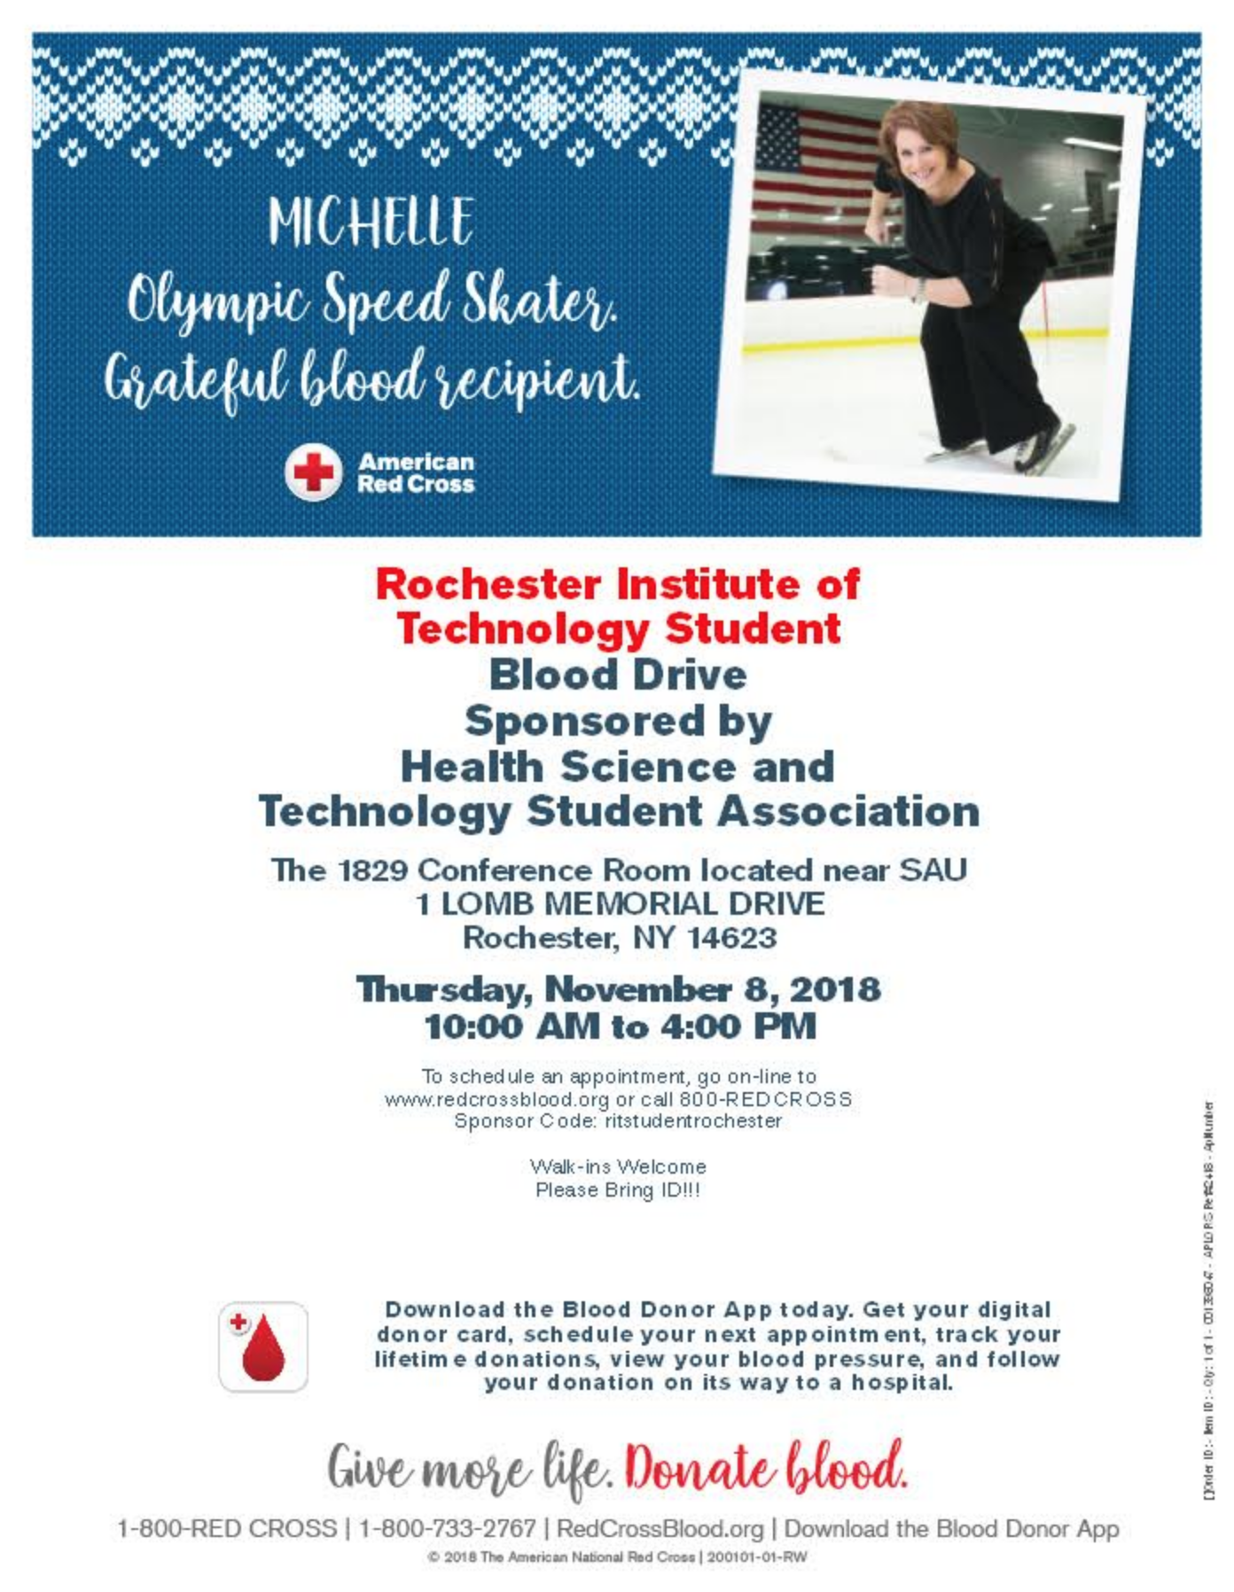
FUTURE EVENTS
Blood Drive
November 8th, 2018
10:00-4:00PM
SAU Fireside Lounge
Link to sign-up: https://docs.google.com/document/d/1J_RBXrC83XpBHQhcIDti_XWmY-SQ99ImdB7JqNHnkvw/edit?usp=sharing
Notes:
LA

Slide 8
FUTURE EVENTS
Professional Development Series: Interviewing
November 12th, 2018
4-5 PM
CBET 1160
Notes:
Jasmine
Dr. Chris Tanski - Upstate Medical University

Slide 9
FUTURE EVENTS
PSA Collaboration: Medical Professional Meet and Greet
November 14th, 2018
5-7 PM
CBET
Practitioners:
- Lindsay Phillips, MD, medical director of the Student Health Center at RIT
- Daniel Taramasco, MD, Hospitalist at RGH
- Donald Bordley, MD, Internist and committee member of UR Med admissions
- Wendy Gelbard, MD, Associate VP of the Wellness Program at RIT
Residents:
- Dr. Prateek Mathur, Internal Medicine resident, RGH
- Dr. Paridhi Malik, Internal Medicine resident, RGH
- Dr. Zach Zmich, Orthopedic Surgery resident, URMC
- Dr. Katherine Jackson, surgery resident, URMC
Notes:
Emilyn

Slide 10
FUTURE EVENTS
iHOP Fundraiser 3-10PM
November 15th, 2018
556 Jefferson Rd, Rochester, NY 14623
3-10 PM
https://www.groupraise.com/events/74856
Notes:
Jasmine

Slide 11
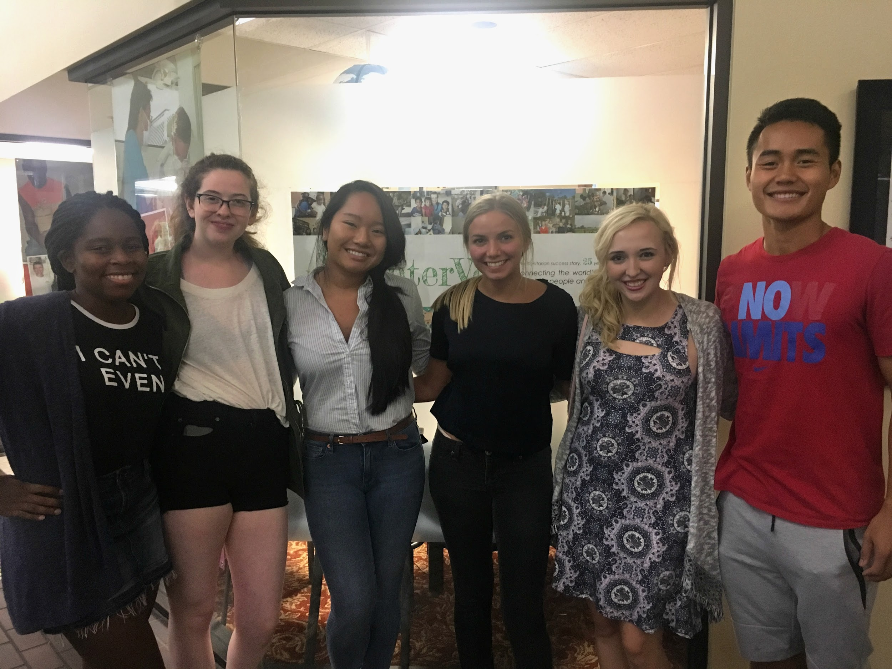
FUTURE EVENTS
HSTSA Volunteers for InterVol
6-8 PM
https://tinyurl.com/hstsaintervol
Notes:
Courtney

Slide 12
FUTURE EVENTS
RRH New Volunteer Opportunity!
It is the MyCare Connect Volunteer! Volunteers here, promote greater patient engagement and participation in their own health-caring by assisting patients in activating their MyCare electronic record account!
Notes:
Here is also a new volunteer position they are starting at RGH! It is the MyCare Connect Volunteer! Volunteers here, promote greater patient engagement and participation in their own health-caring by assisting patients in activating their MyCare electronic record account!

Slide 13
SOCIAL MEDIA

Slide 14
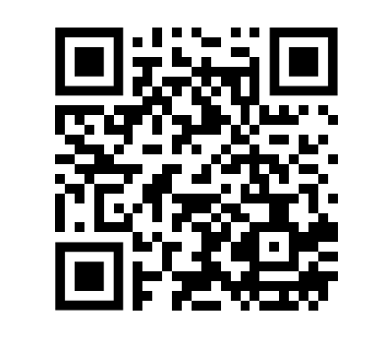
Questions? Feedback/Ideas?
https://goo.gl/forms/rDJXcrxZRQFHkPC03

